Slide 1






AUTOMATED SENTIMENT ANALYSIS, CLUSTERING AND SUMMARIZATION OF AMAZON BOOK REVIEWS
João Peseiro

Slide 2
Project objective:
Classify customer reviews by sentiment
Cluster reviews into thematic categories
Summarize reviews per category
Recommend top books by category
Motivation: Handle large-scale Amazon reviews dataset automatically
INTRODUCTION

Slide 3

DATASET OVERVIEW
Dataset: Amazon book reviews (~100,000 reviews)
Data format: compressed JSON Lines (.jsonl.gz)
Text, Title, User ID, Review Title, Review text, Rating, Images, Timestamp...

Slide 4


DATA LOADING AND PREPROCESSING
Load compressed JSON with gzip and json
Limit to 100,000 lines for performance
Basic text cleaning: lowercasing, remove URLs, punctuation, extra spaces
Create clean_text column

Slide 5
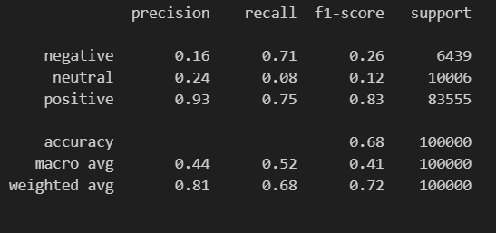
SENTIMENT CLASSIFICATION
Use HuggingFace Transformer: lxyuan/distilbert-base-multilingual-cased-sentiments-student
Limit input text to 512 tokens
Predict sentiment labels: positive, neutral, negative
Map original ratings to sentiment labels

Slide 6
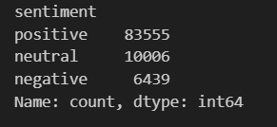
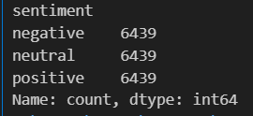
DATA BALANCING
Class imbalance problem
Balanced dataset creation by downsampling to smallest class count
Apply classification again on balanced data

Slide 7
CLUSTERING REVIEWS BY THEME (FEW-SHOT WITH GPT)
Split clean texts into batches (max 20)
Prompt GPT-4o-mini to cluster texts into exactly 5 categories per batch
Parse GPT responses to assign category labels to reviews
Show example prompt and GPT response format

Slide 8
CATEGORY NORMALIZATION (KMEANS + TF-IDF)
Categories from GPT clustering noisy/overlapping
Normalize category names:
Clean category strings (lowercase, remove accents, punctuation)
Filter categories with ≥ 5 occurrences
TF-IDF vectorization with unigrams and bigrams
KMeans clustering into 10 clusters
Choose representative category per cluster by frequency
Show snippet of normalization code and result

Slide 9
REVIEW SUMMARIZATION PER CATEGORY (OPENAI GPT)
For each normalized category, sample up to 100 reviews
Concatenate and limit text length for prompt (~4000 tokens)
Prompt GPT-4o for concise, representative summary
Show example prompt and sample summary output

Slide 10
TOP BOOK RECOMMENDATION PER CATEGORY
Aggregate ratings by book title
Filter reviews per category and rating threshold (≥4)
Sort and show top 5 books with example review snippet
Example output

Slide 11


RESULTS AND INSIGHTS
Number of categories after normalization (around 8-10)
Balanced sentiment classification metrics
Cluster coherence and category naming quality
Summaries represent well the customer opinions
Example recommendations are relevant and diverse

Slide 12



CONCLUSION
GPT zero-shot clustering can be inconsistent
Manual merging needed for best category coherence
Summarization limited by token limits and prompt design
Future: Use fine-tuned models or supervised classifiers for categories
Automate merging/refinement steps further
Successfully built pipeline for sentiment, clustering, normalization, summarization and recommendation
Utilized transformers and GPT models effectively
Demonstrated approach scalable for large text datasets
Can be adapted for other product categories or domains

